Slide 1

IBM Data Science Capstone Project
Yaxuan XUE

Slide 2
Introduction
I have been always longing to visit Orlando, Florida.
In this project, I will use Foursquare to choose our ideal hotels that are close to our destination—Universal Studios Florida, and at the same time has a relatively good rating.
Then, I will make a list of nearby restaurants that are located walking-distance from our selected hotel.
Finally,I will build an ARIMA model using the active cases data of United States to predict when this COVID-19 can be under control.

Slide 3
Data preparation
1) address of the Universal Studios Florida:
6000 Universal Blvd, Orlando, FL
2) active COVID-19 cases in the United States
source: https://www.coronanet-project.org/download
Total Active Cases = Total Positive Cases - Total Deaths - Total Recovered

Slide 4
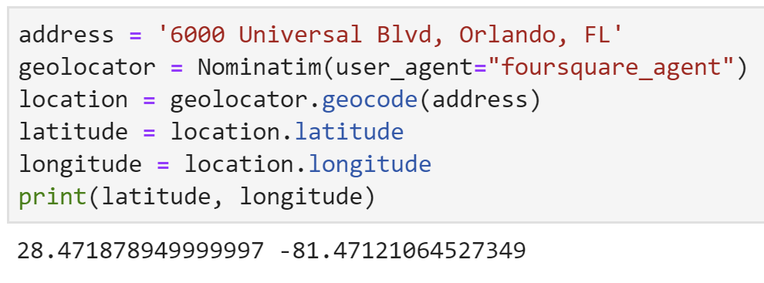
Accommodation
Getting latitude and longitude coordinates

Slide 5
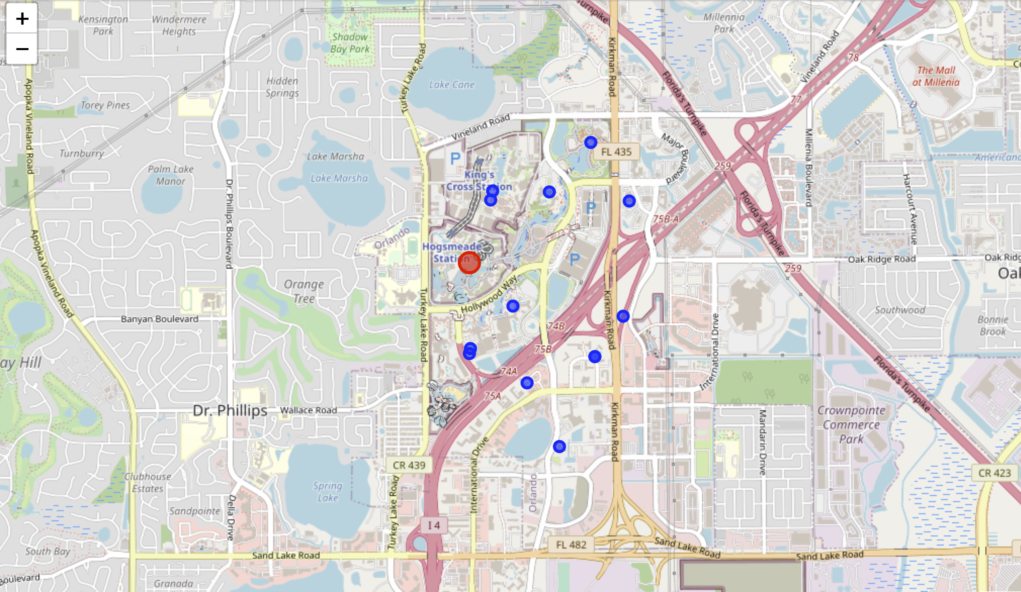
Searching nearby hotels

Slide 6
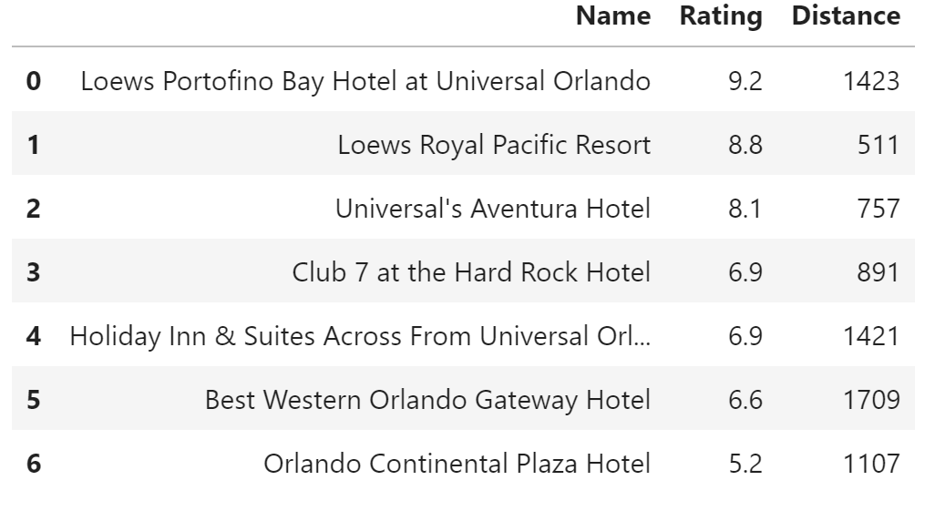
Comparing the ratings

Slide 7
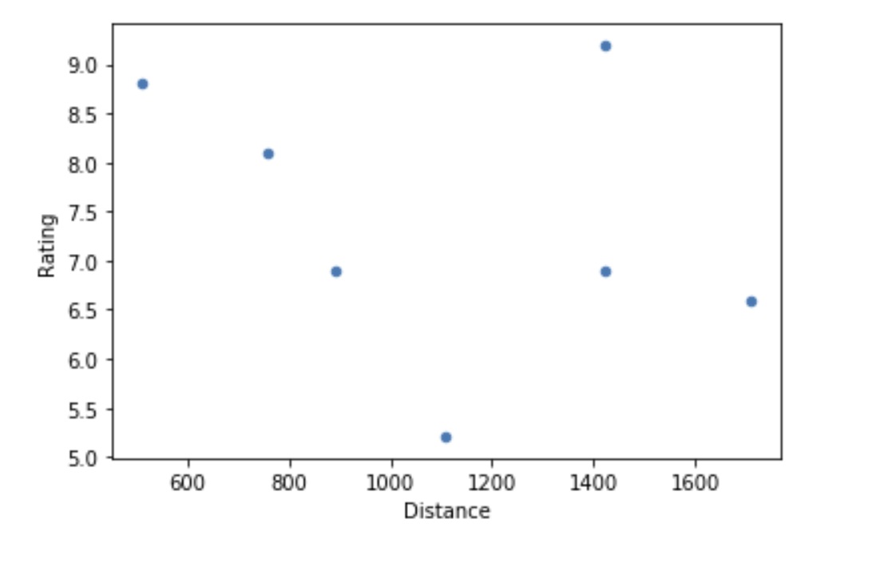
From the plot, the point in red circle which represents Loews Royal Pacific Resort seems to be the most ideal hotel that meets our requirements.

Slide 8
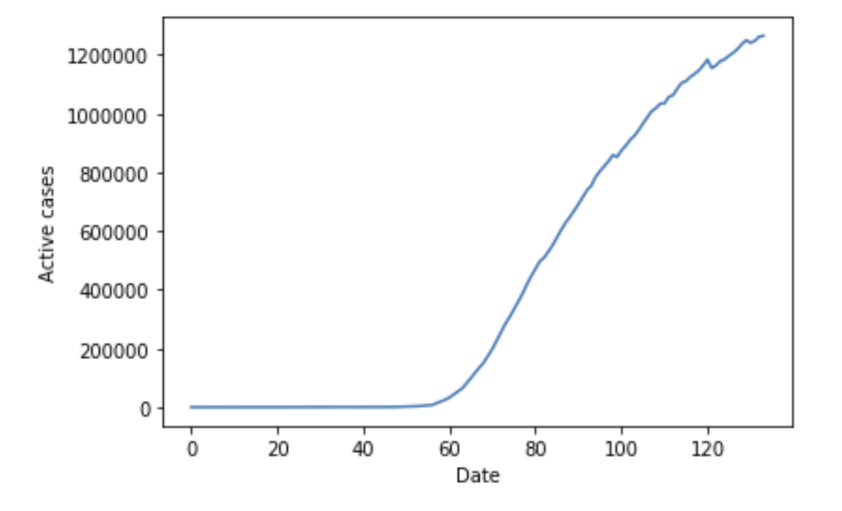
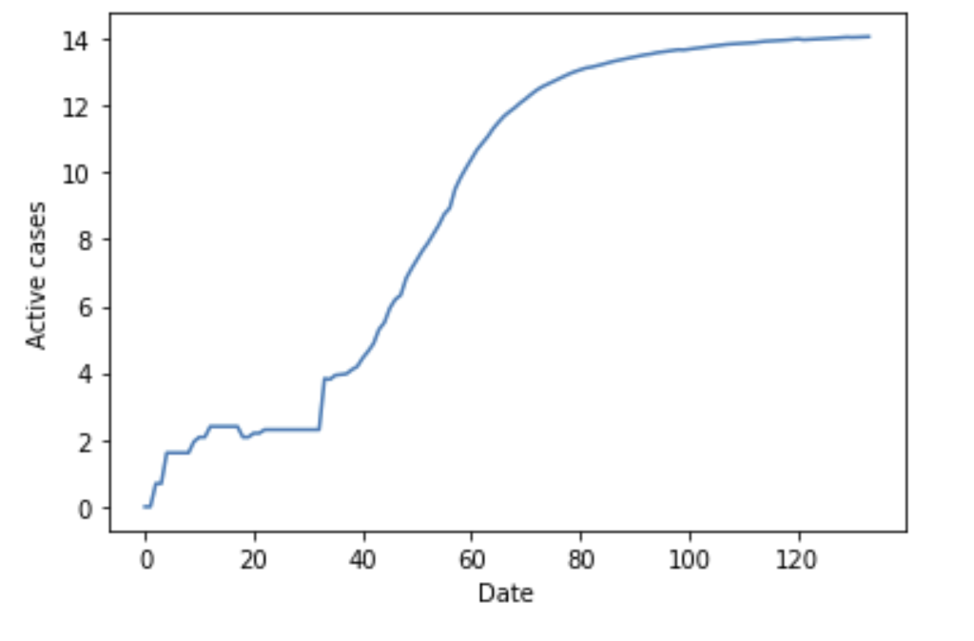
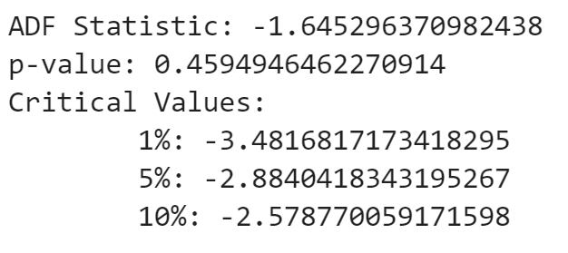
COVID-19 Active Cases Study
Active cases
log(active cases)
ADF test
Active cases
Log(active cases)

Slide 9
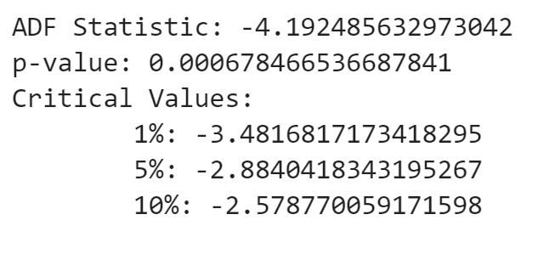
ADF test
First difference of log(active cases)
The first difference of log(active cases) is stationary. We can then use this series to run ARMA regression.

Slide 10
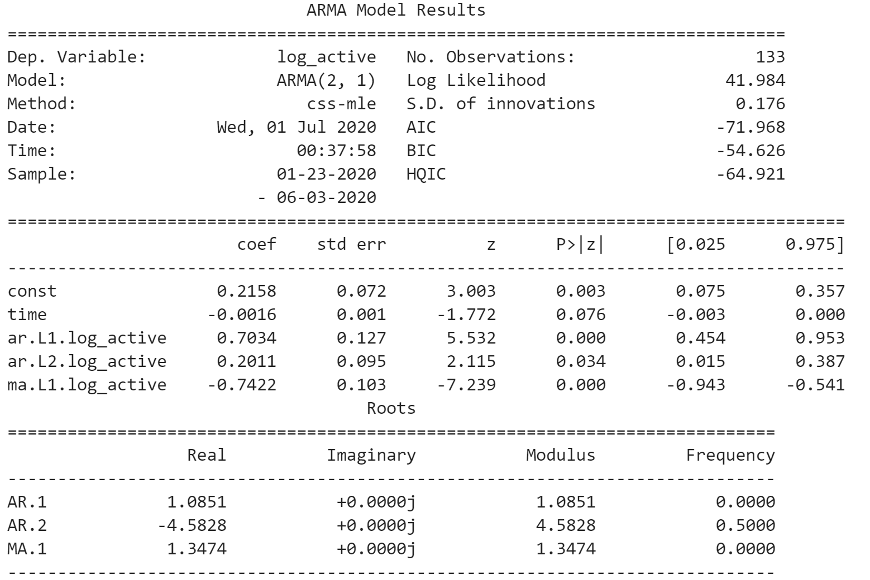
2. Regression

Slide 11
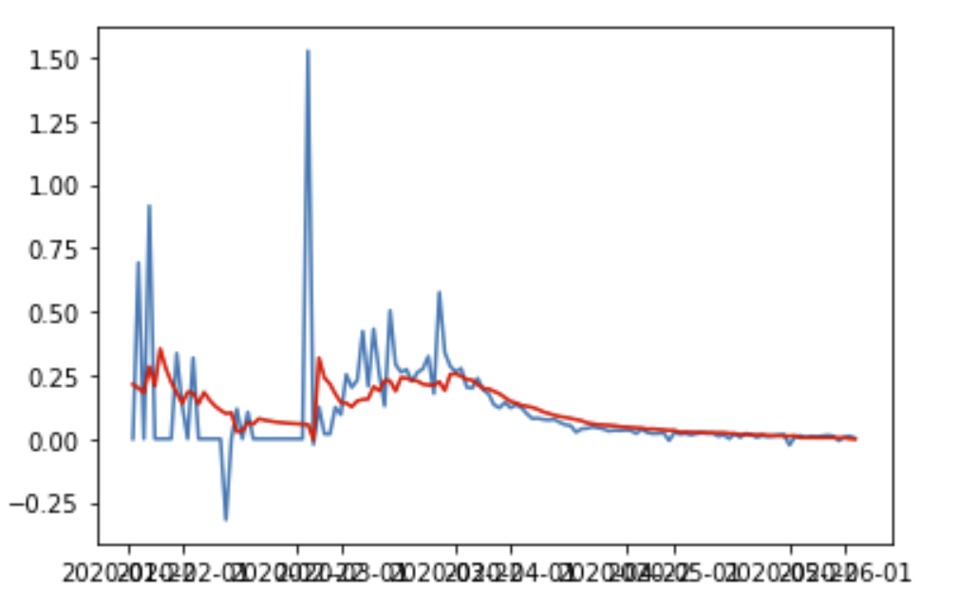
3. Fitting the model

Slide 12
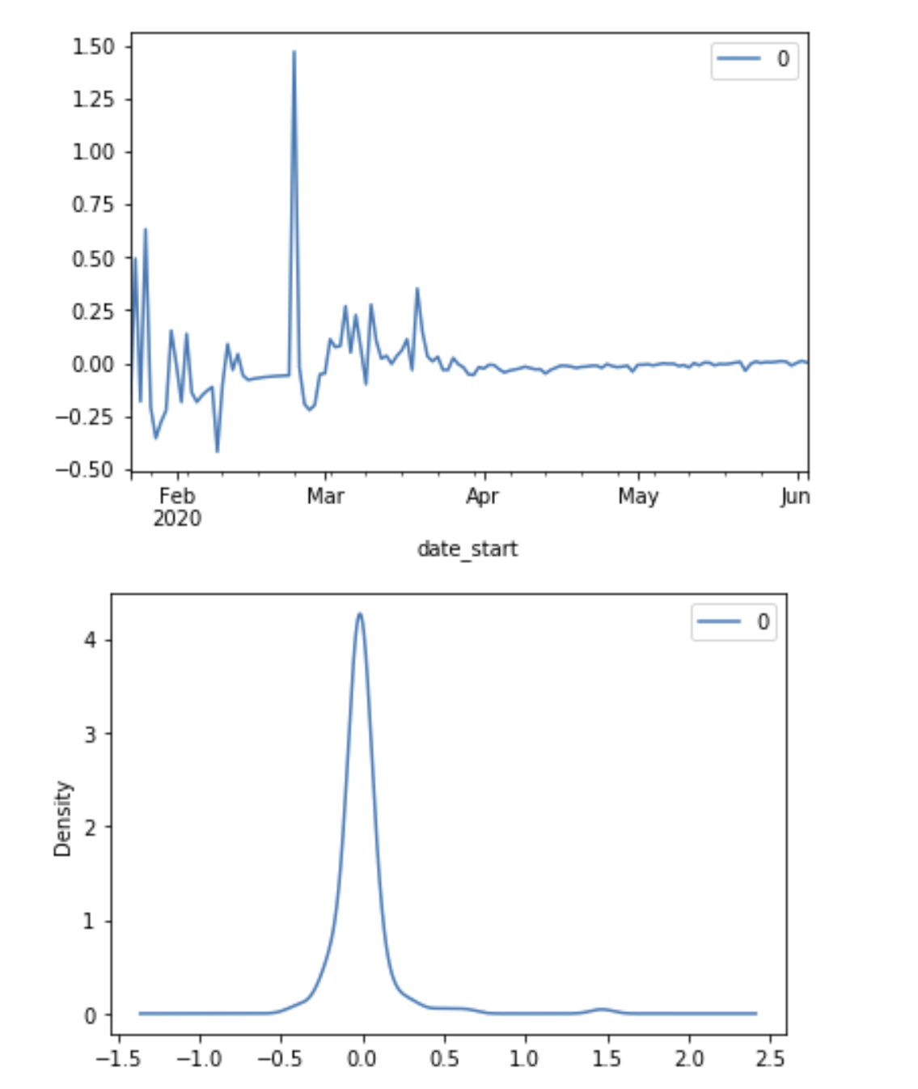
3. Fitting the model
Residuals—White noise

Slide 13
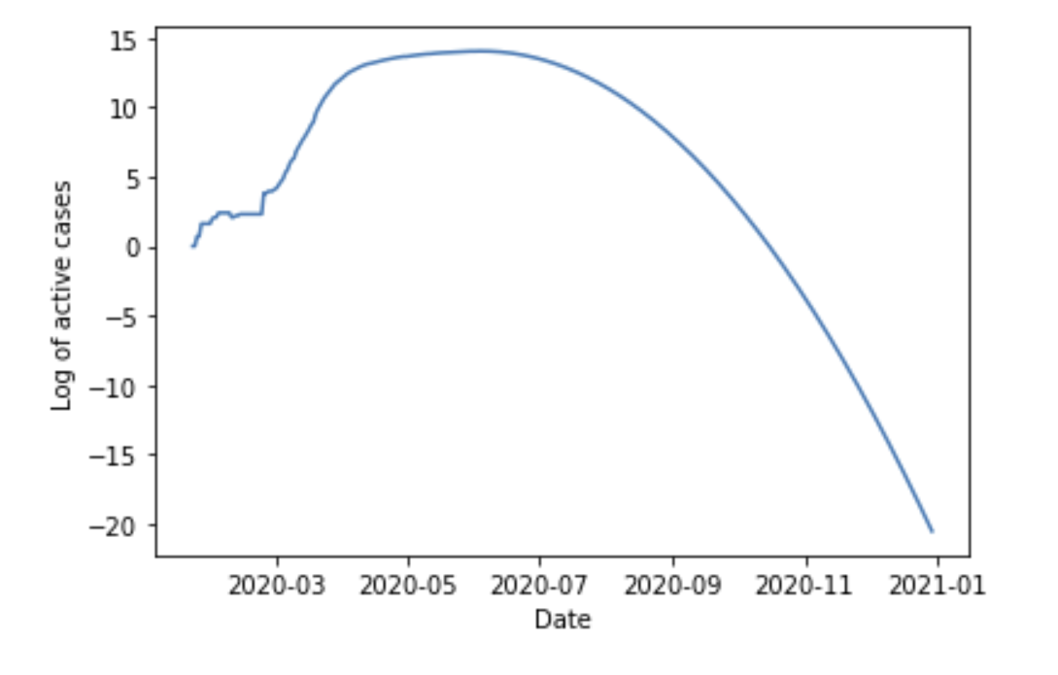
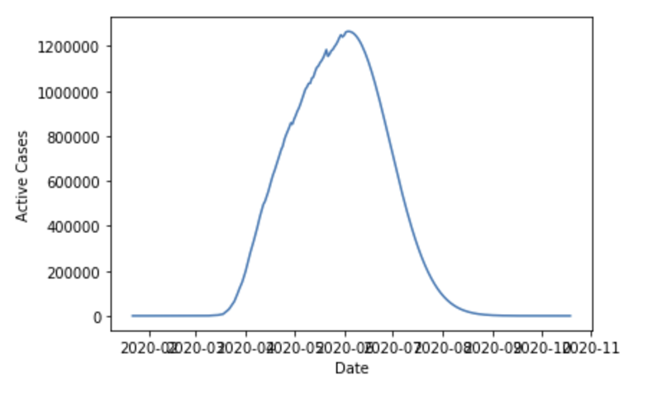
4. Forecasting

Slide 14
Results
Thanks to Foursquare, I found our ideal hotel for the vacation. Loews Royal Pacific Resort seems to be the most suitable hotel for my friend and I to stay in. And around the hotel, there are 15 restaurants that serve cuisines from all over the world.
If nothing unexpected happens and everything goes smoothly as right now, from the ARIMA model I built, the active cases of the U.S. should come to zero in late October.

Slide 15
Conclusion
By using data collected in Foursquare, now I have some ideas about my future trip to Orlando, such as which hotel to stay in so that we can be extremely close to the Universal Studios and enjoy excellent services, and which restaurants to go to that has cuisines from all over the world. I believe this report can also be a good small guidance to people who have the same interests and plans as I do.
With the help of several Python libraries, I have built an ARIMA model to predict when the active cases in the United States can be zero and when it may be safe to travel around the country again. If everything goes as I expected, according to the model, the situation should be alleviated by the end of October.

Slide 16
Thank you!!!

